Slide 1

Spring Data
Course Introduction
SoftUni Team
Technical Trainers
Software University
https://softuni.bg

Slide 2
Table of Contents
Course Objectives & Program
The Training Team
Course Organization
Homework
Exam
Resources

Slide 3
Questions
sli.do #Java-DB

Slide 4














SoftUni Diamond Partners

Slide 5


Course Objectives & Program
Spring Data

Slide 6


Course Objectives
The Spring Data course covers
Connecting to local DB instance
ORM, Hibernate and Spring Data
Code-First implementations
Programming Patterns
Working with data in other formats (XML, JSON)

Slide 7



Course Topics
Database Access With JDBC
ORM Fundamentals
Introduction to Hibernate
Hibernate Code First
Introduction to Spring
Spring Data Intro

Slide 8
Course Topics (2)
Spring Data Advanced Querying
Spring Data Auto Mapping Objects
JSON Processing
XML Processing
Exam Preparations
Workshop – MVC Project

Slide 9

The Training Team

Slide 10
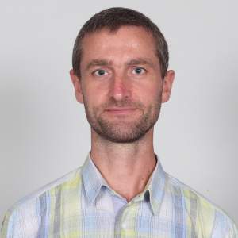
Trayan Iliev
Developer of end-to-end reactive full-stack applications and services using ES, TypeScript, Angular, React and Vue.js clients, and Spring 5, Reactor, Kafka, Pulsar, RabbitMQ, Express and Java EE back-ends.
15+ years of software development experience and 12+ years experience as enterprise IT trainer - https://www.linkedin.com/in/trayaniliev/.
CEO of IPT – Intellectual Products & Technologies - http://iproduct.org/ – training and consultancy company, focused on novelties in front-end and REST/ gRPC/ GraphQL backend development – reactive UI, end-to-end reactive programming, distributed event stream processing, real-time micro-service architectures.
Has presentations on local developer conferences such as Voxxed Days, jPrime, jProfessionals, BGOUG, on topics like Spring 5, Reactor, SOA & REST, CDI, Java EE, React, Angular, Ionic, RxJS, reactive and high-performance java
He is robotics / smart-things/ IoT enthusiast and organizes RoboLearn hackathons in Sofia.

Slide 11
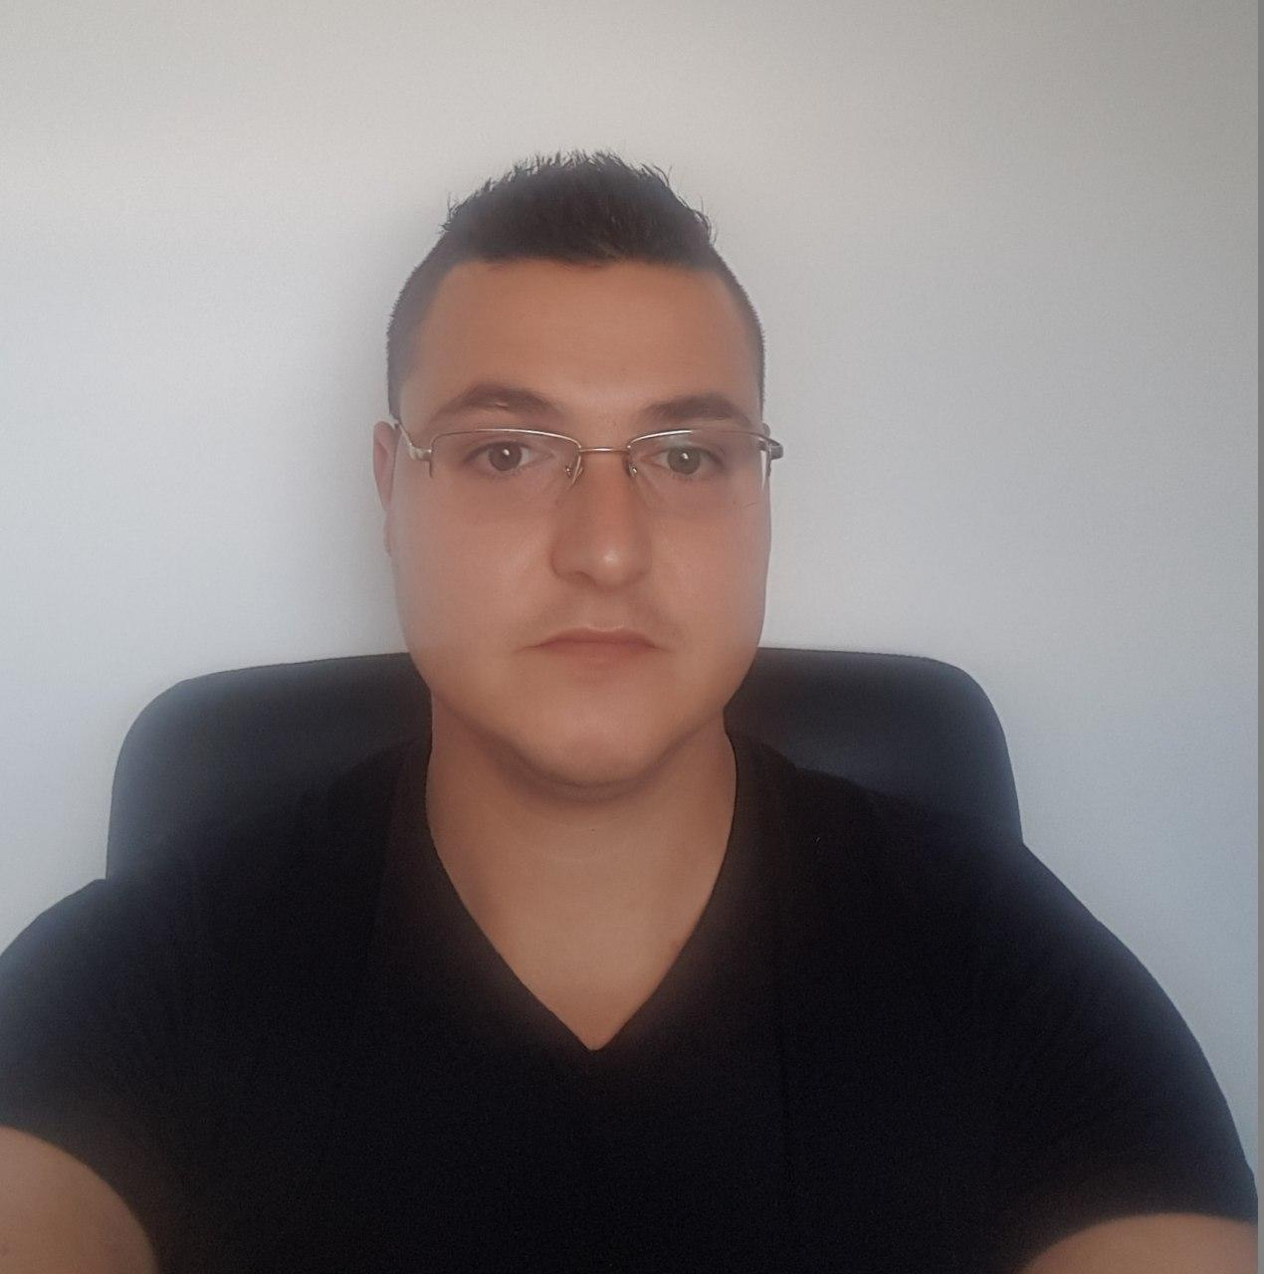
Chavdar Mitkov
Technical Trainer @ SoftUni
Team Lead of:
Java DB Module January 2020
Java Web Module May 2020
Experience with MySQL , Hibernate, Spring MVC
Interested in Java, JavaScript, Angular, Kotlin

Slide 12

Course Organization

Slide 13
Java DB Module – Timeline
14-Sep-2020
19-Oct-2020
02-Dec-2020
MySQL
4 weeks * 4 times / week
9 credits
Start: 14-Sep-2020 Final exam: 18-Oct-2020
Spring Data
7 weeks * 4 times / week
15 credits
Start: 19-Oct-2020
Final exam: 28-Nov-2020
Re-Take Exams

Slide 14


SoftUni Certificate
Practical Exam 100%
Homework 5%
Evaluation
14

Slide 15
CPE Certificate
Theoretical Exam 100%
Evaluation
15

Slide 16

Homework Assignments & Exercises
Your homework is mainly work in class!
Lesson days → slides + live demos + exercises
Exercise days → only exercises
How to submit your homework?
Submitted on the course page in softuni.bg
Exam - Project

Slide 17
Resources
What We Need Additionally?

Slide 18


Java DB Course Web Site, Forum and FB Group
Official web site:
Official discussion forum:
https://softuni.bg/trainings/3015/spring-data-october-2020
https://softuni.bg/forum/categories/78/databases-advanced-hibernate

Slide 19


The MySQL Slides and Videos
All lecture slides, videos, homework assignments, projects and other resources are open content, available for free
Visit the course web site to access the course resources

Slide 20



Learn to Search in Internet
The course assignments require to search in Internet
This is an important part of the learning process
Some exercises intentionally have no hints
Learn to find solutions!
Software development includes everyday searching and learning
No excuses, just learn to study!
Developers learn new technologies, tools, languages every day!

Slide 21
Questions?
Notes:
21

Slide 22
Trainings @ Software University (SoftUni)
Software University – High-Quality Education, Profession and Job for Software Developers
softuni.bg, about.softuni.bg
Software University Foundation
softuni.foundation
Software University @ Facebook
facebook.com/SoftwareUniversity
Software University Forums
forum.softuni.bg
Notes:
22

Slide 23

License
This course (slides, examples, demos, exercises, homework, documents, videos and other assets) is copyrighted content
Unauthorized copy, reproduction or use is illegal
© SoftUni – https://about.softuni.bg/
© Software University – https://softuni.bg
Notes:
23

